Slide 1

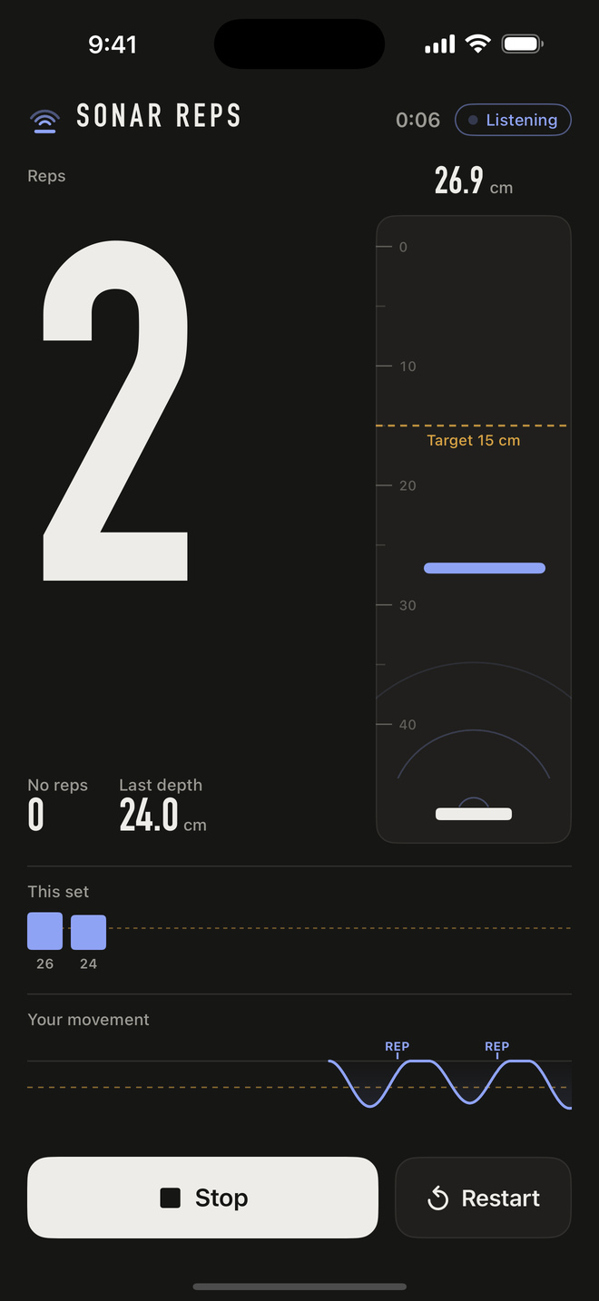
SONAR REPS
INVISIBLE AI
Your phone counts push-ups with sound you cannot hear.
No camera
Nothing to wear
Nothing to tap mid-set
Notes:
0:00, Speaker 1. Quick question. How do you count push-ups without a camera, a watch, or touching your phone? You put the phone on the floor and let it listen.

Slide 2
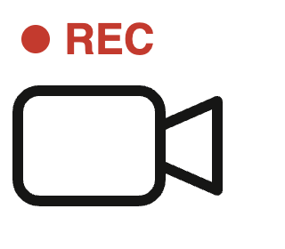
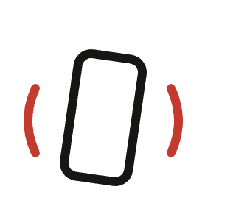
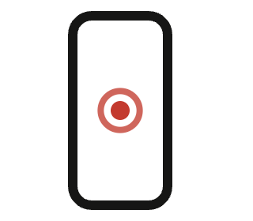
Rep counters make you manage a screen.
THE PROBLEM
Camera counters
Motion counters
Both
Film yourself.
A shake counts as a rep.
A screen to tend mid-set.
What if the phone just listened?
Notes:
0:10, Speaker 1. Right now rep counters make you work for it. Camera ones want you to film yourself. Motion ones count a shake as a rep. Either way you're poking a screen mid-set. So how does ours work? (hand to Speaker 2)

Slide 3
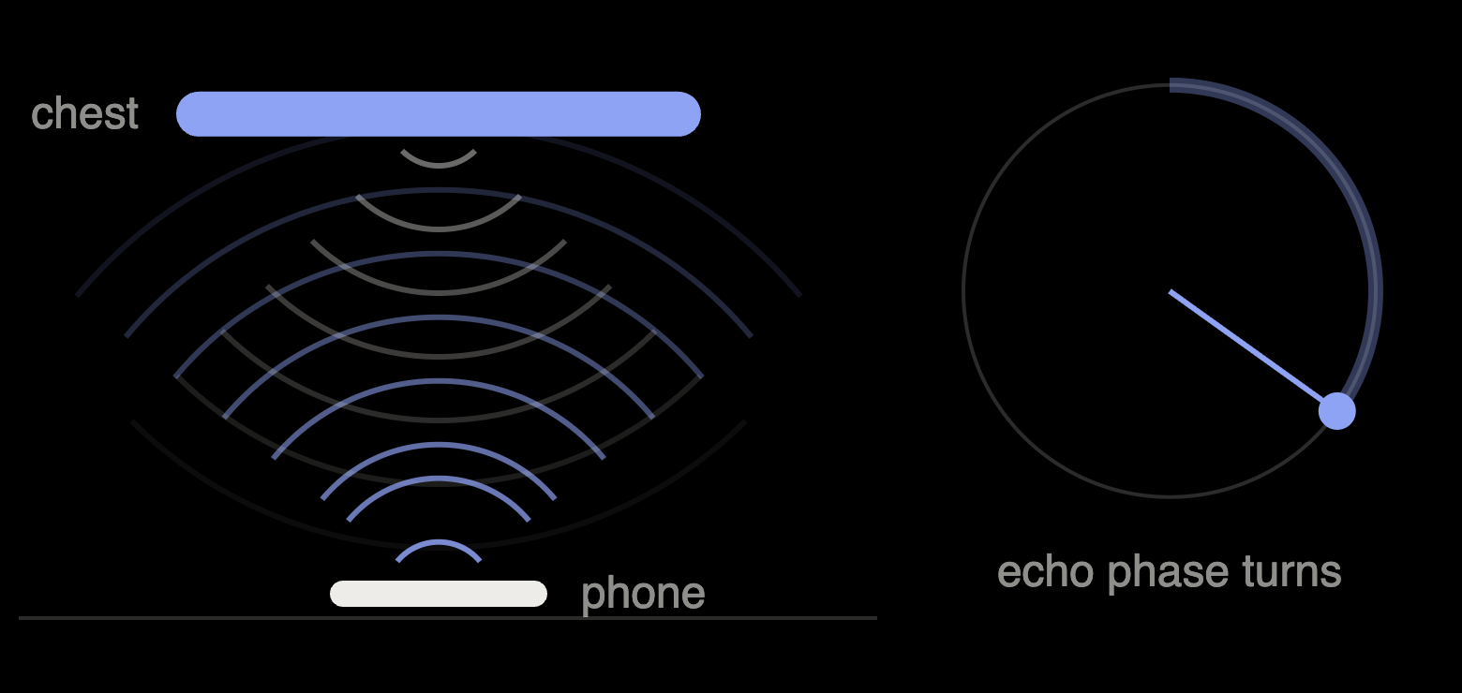
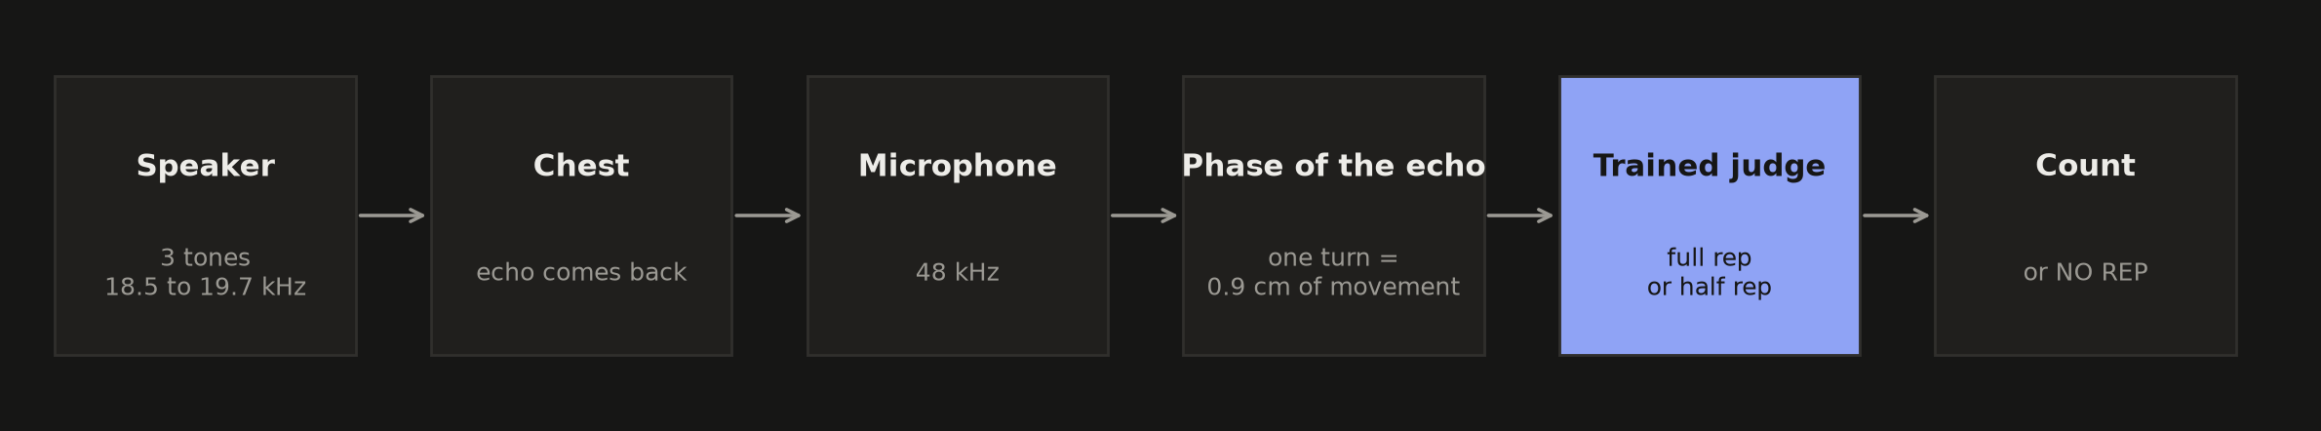
Sound out. Echo back. Chest tracked.
HOW IT WORKS
18.5 · 19.1 · 19.7 kHz
Three tones, too high to hear
0.9 cm
of chest movement per turn of echo phase
About 28 turns
in one push-up
Builds on published phase-tracking work: LLAP; Fu et al. 2018.
Notes:
0:24, Speaker 2. Sound. The phone plays three tones most of us can't hear, and listens for the echo off your chest. As you move, the echo's phase turns. Each turn is 0.9 of a centimetre, so one push-up is about 28 turns.

Slide 4
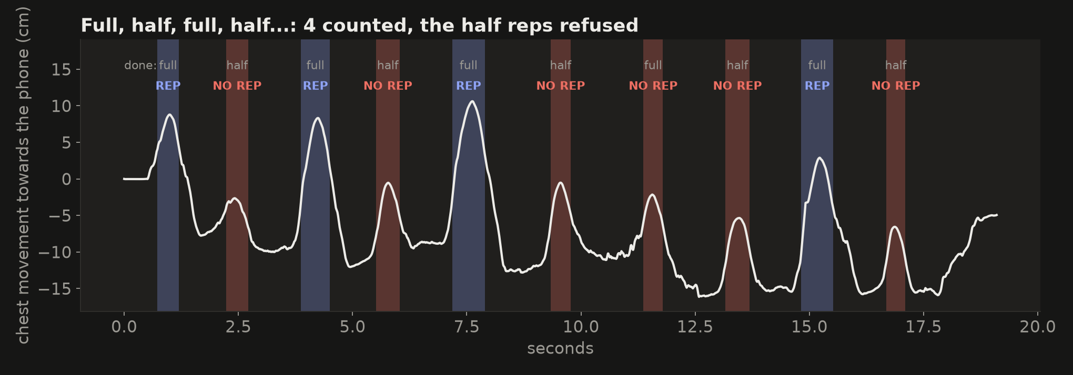

Full, half, full, half.
IT SEES DEPTH
Half reps: 5 of 5 refused
Full reps: 4 of 5 counted
Notes:
0:40, Speaker 3. And it really sees depth. This is a real recording: full, half, full, half. That line is the chest, and every half rep got refused.

Slide 5
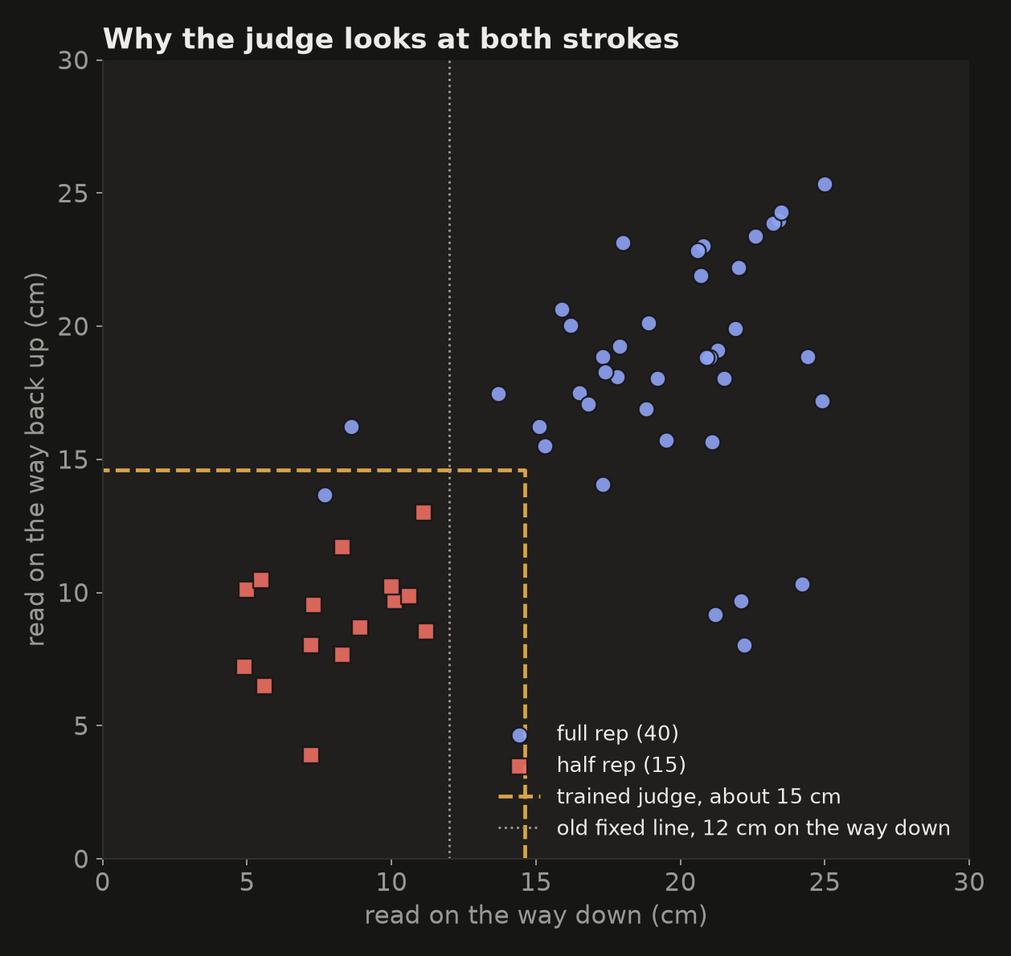

A model we trained judges every rep.
WE TRAINED IT
Line: refused
Model: counted
55 labelled push-ups. Tested on sets it never saw.
Fixed depth line
53 of 55
Trained judge
54 of 55
Notes:
0:50, Speaker 4. So where's the AI? Sound gives us the movement. Then a small model, trained on 55 of our own push-ups, decides: full rep or not. On sets it had never seen it got 54 of 55. A fixed depth line got 53. This rep is why (point at the pulsing dot): it read short on the way down, but the model checks both strokes, so it counted.

Slide 6
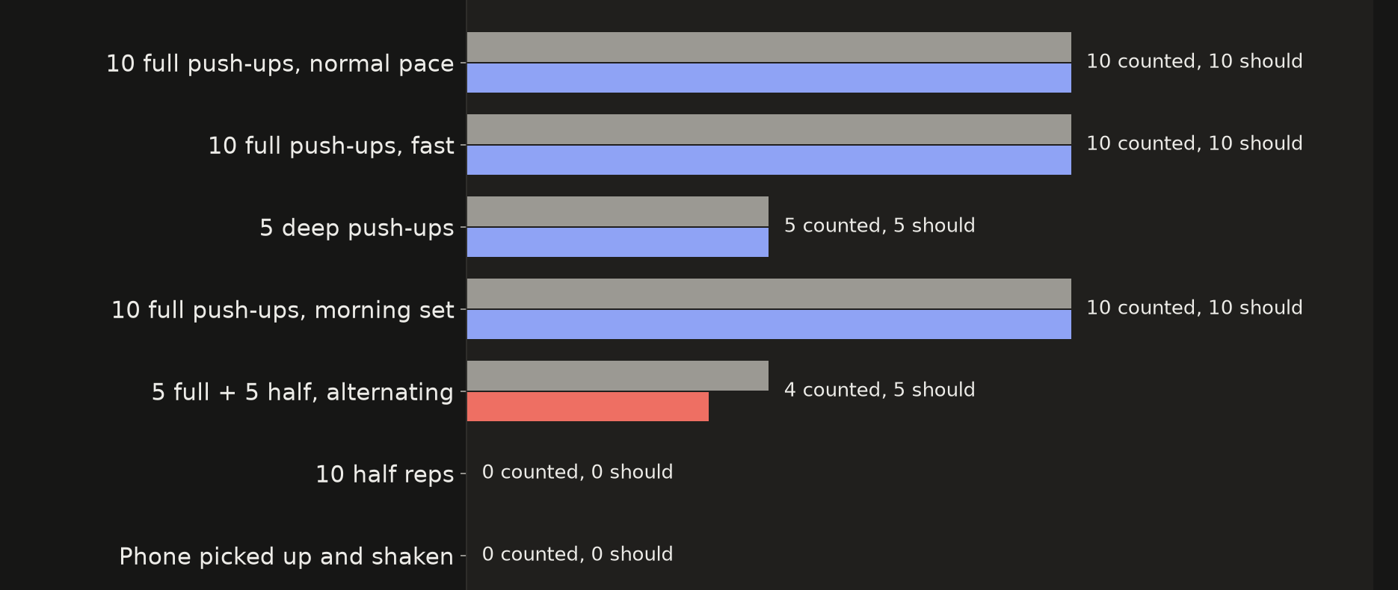
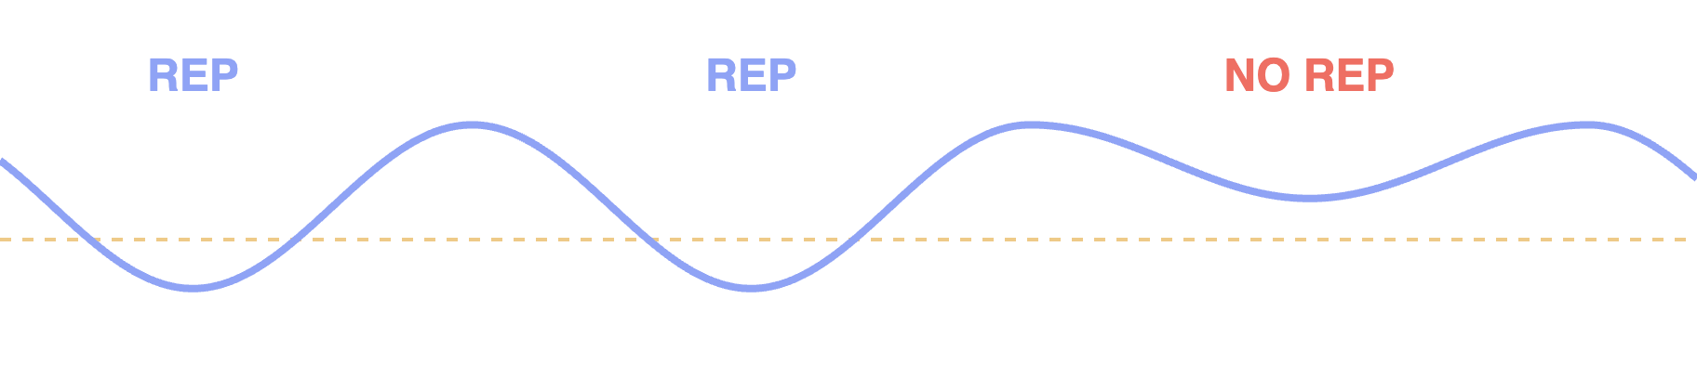
Tested on sets the model never saw.
RESULTS
39 of 40
full push-ups counted
15 of 15
half reps refused
0
counted when the phone moved
Notes:
1:14, Speaker 4. Overall: 39 of 40 full push-ups counted, 15 of 15 half reps refused, and move the phone, nothing counts.

Slide 7
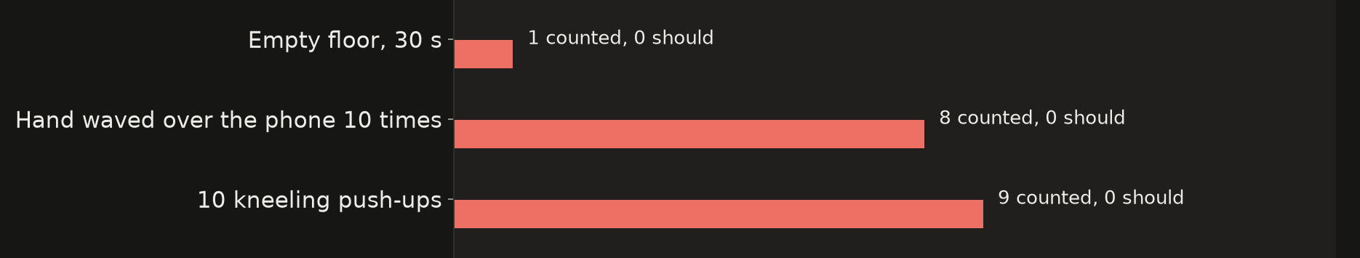
We measured the failures too.
WHAT IT CANNOT DO YET
A hand can pass for a chest
One person tested
It sees a surface move, not what it is.
One iPhone, one afternoon.
Notes:
1:22, Speaker 2. It's not perfect, and we tested that too. A hand waved over it still counts. So do kneeling push-ups. And so far it's one person, one phone.

Slide 8

You never see the model. You see a count, or NO REP.
WHY THIS IS INVISIBLE AI
01
02
03
Invisible sensing
Invisible interface
Invisible footprint
No camera. Nothing to wear.
No chat. No buttons mid-set.
No image of you. No speech kept.
Notes:
1:33, Speaker 1. That's why we'd call it invisible AI. No camera, nothing to wear, no chat, no buttons. You never see the model, just a count, or NO REP.

Slide 9

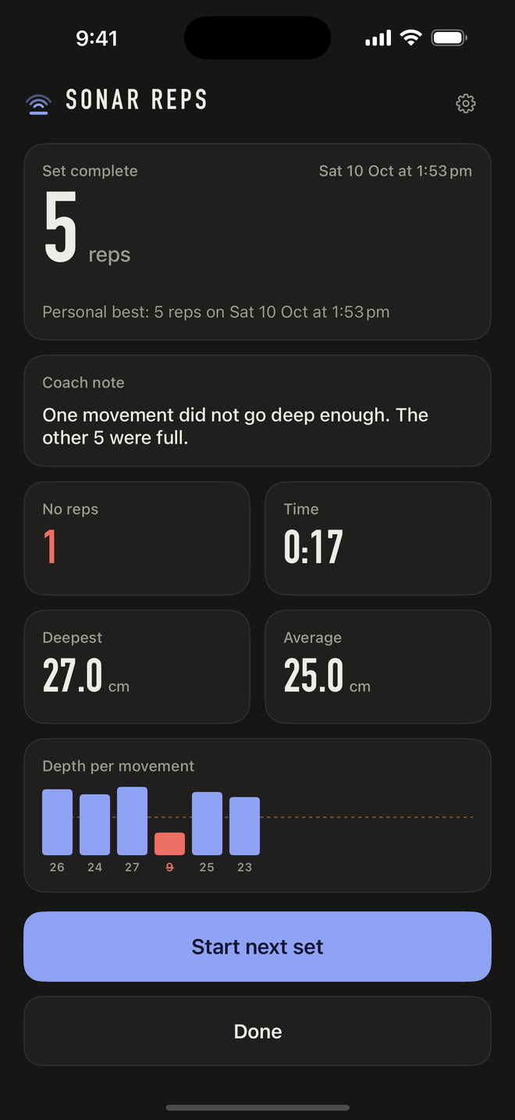
Where it goes next.
NEXT
Run it all on the phone
No laptop needed.
Add distance
So a hand cannot pass for a chest.
More people, floors, phones
More labelled sets, better judge.
PUT YOUR PHONE DOWN. TRAIN.
Notes:
1:44, Speaker 2. Next: run it all on the phone, add distance so a hand can't fake a chest, and test it on more people. But enough talking. Show them. (hand to Speaker 3)

Slide 10
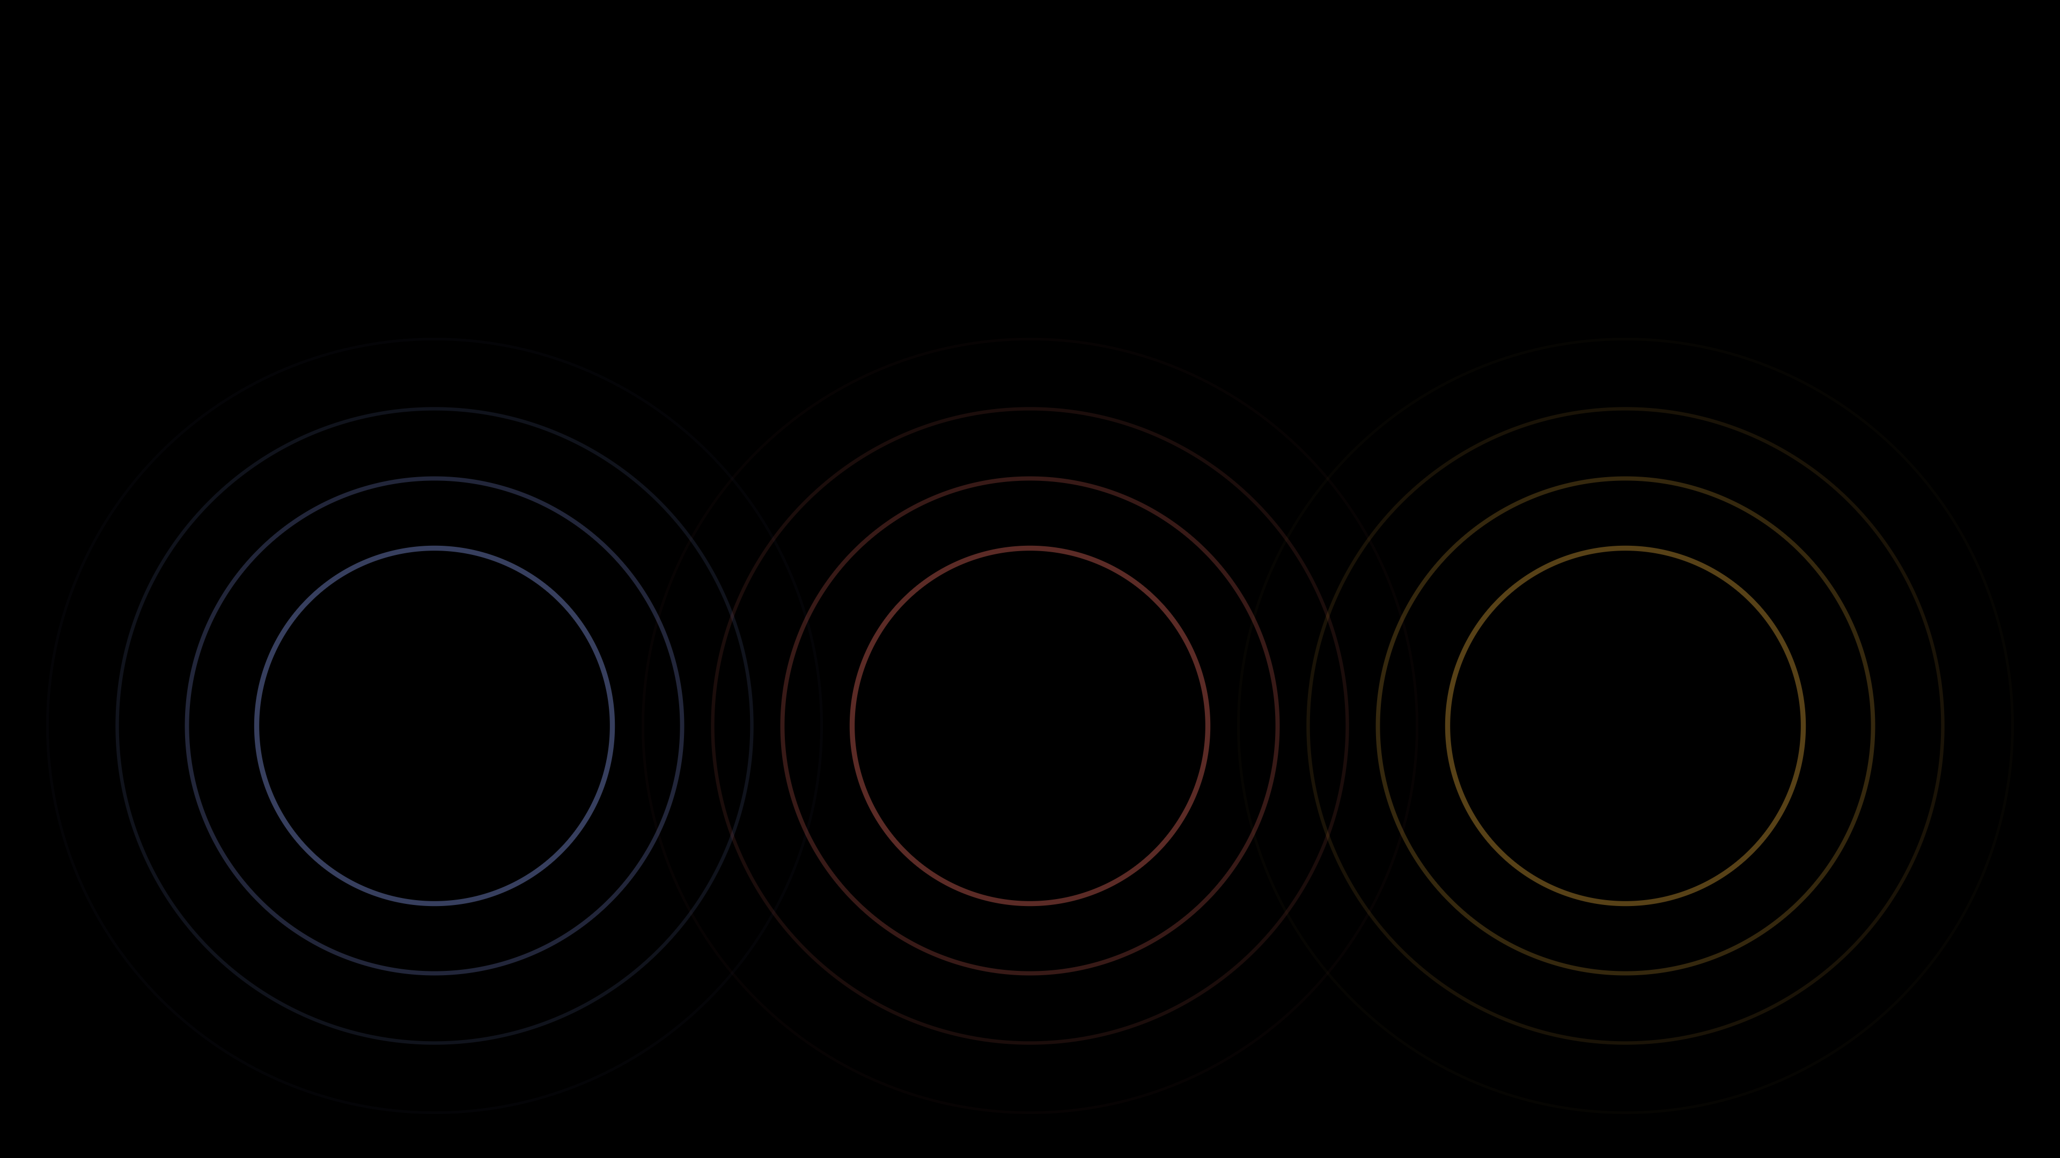
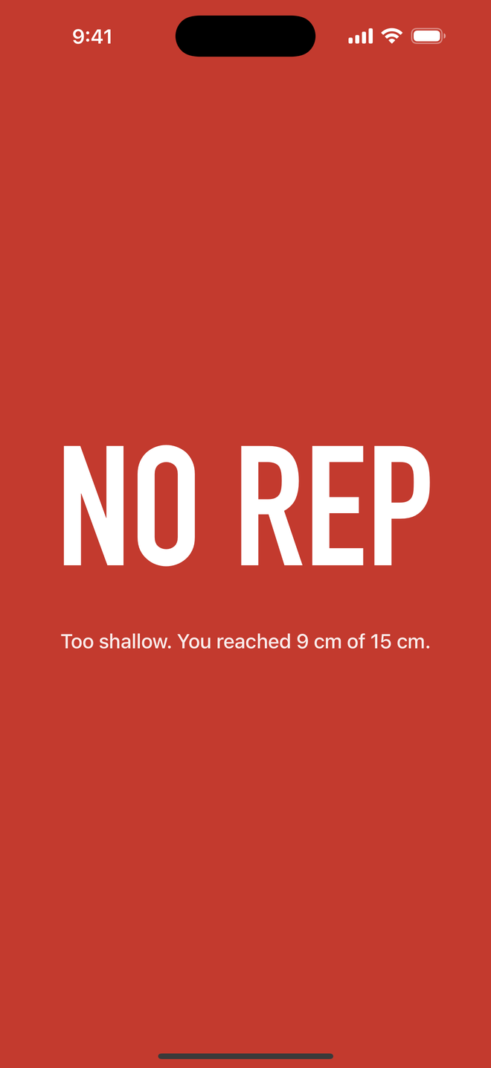
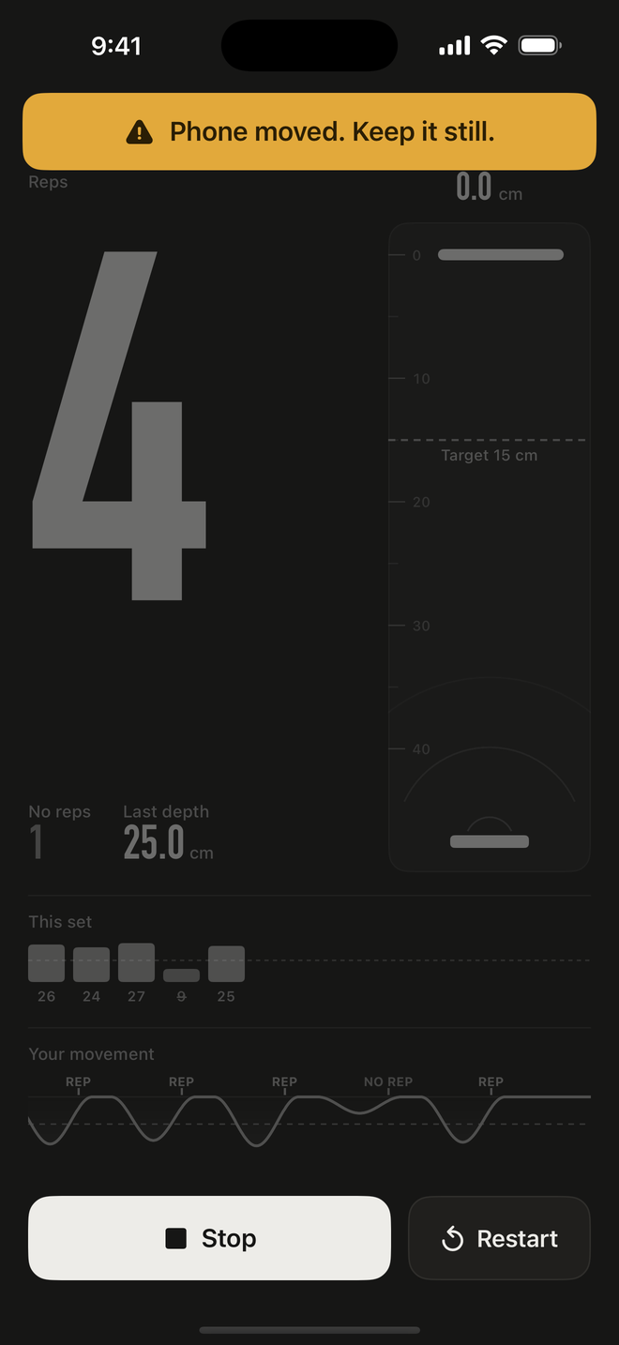
Put it down. Press Start. Train.
LIVE DEMO
Full rep
Half rep
Phone moved
Counts
NO REP
Stops counting
Notes:
1:55 to about 2:55, Speaker 3 narrates; someone else does the push-ups. Cut to the uncut demo footage; click to reveal each state as it happens. Phone face-up on the floor, press Start, hands off. (5 full reps) Every full one counts. (1 half rep) Half rep: NO REP. (pick up and shake the phone) Move the phone and it stops. That's Sonar Reps. Put your phone down and train.

